Slide 1
Open Lab 7: Transformer-Based Models

Slide 2
Machine Learning and Deep Learning Series
Open Lab 1: Introduction to Machine Learning and Deep Learning
Open Lab 2: Supervised Learning – Classification
Open Lab 3: Supervised Learning – Regression
Open Lab 4: Unsupervised Learning
Open Lab 5: Advanced ML – Ensemble Learning and Optimization
Open Lab 6: Deep Learning and Neural Networks
Open Lab 7: Transformer-based Models

Slide 3
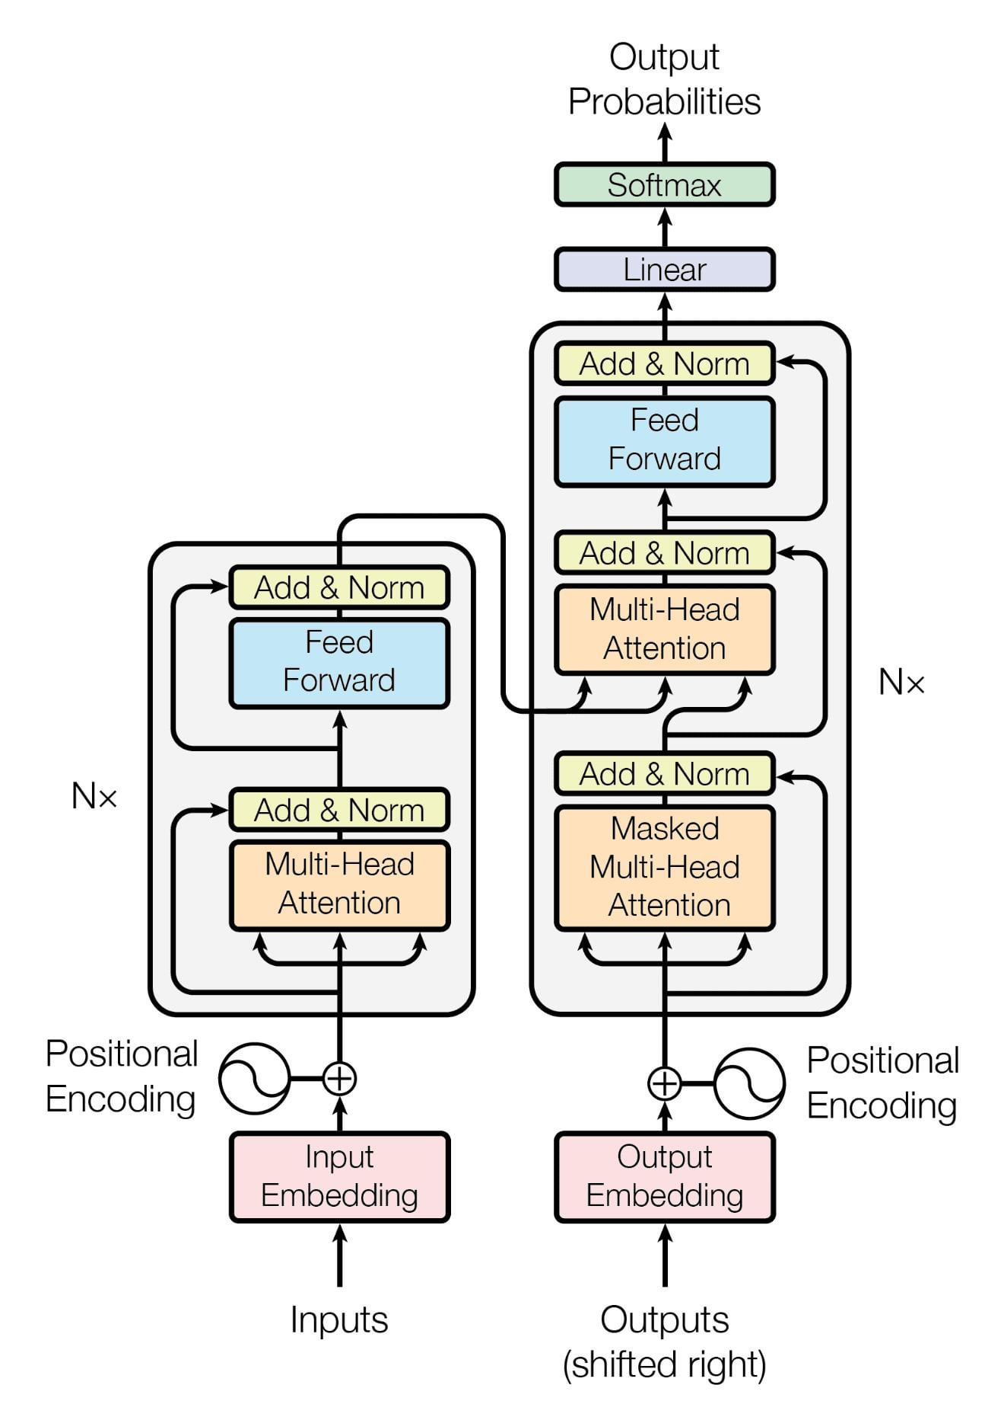
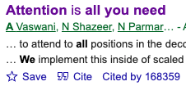
Transformer Architecture

Slide 4
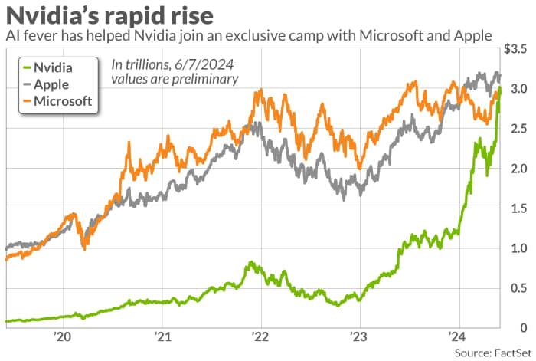
All Become Possible with Advances in GPU…

Slide 5
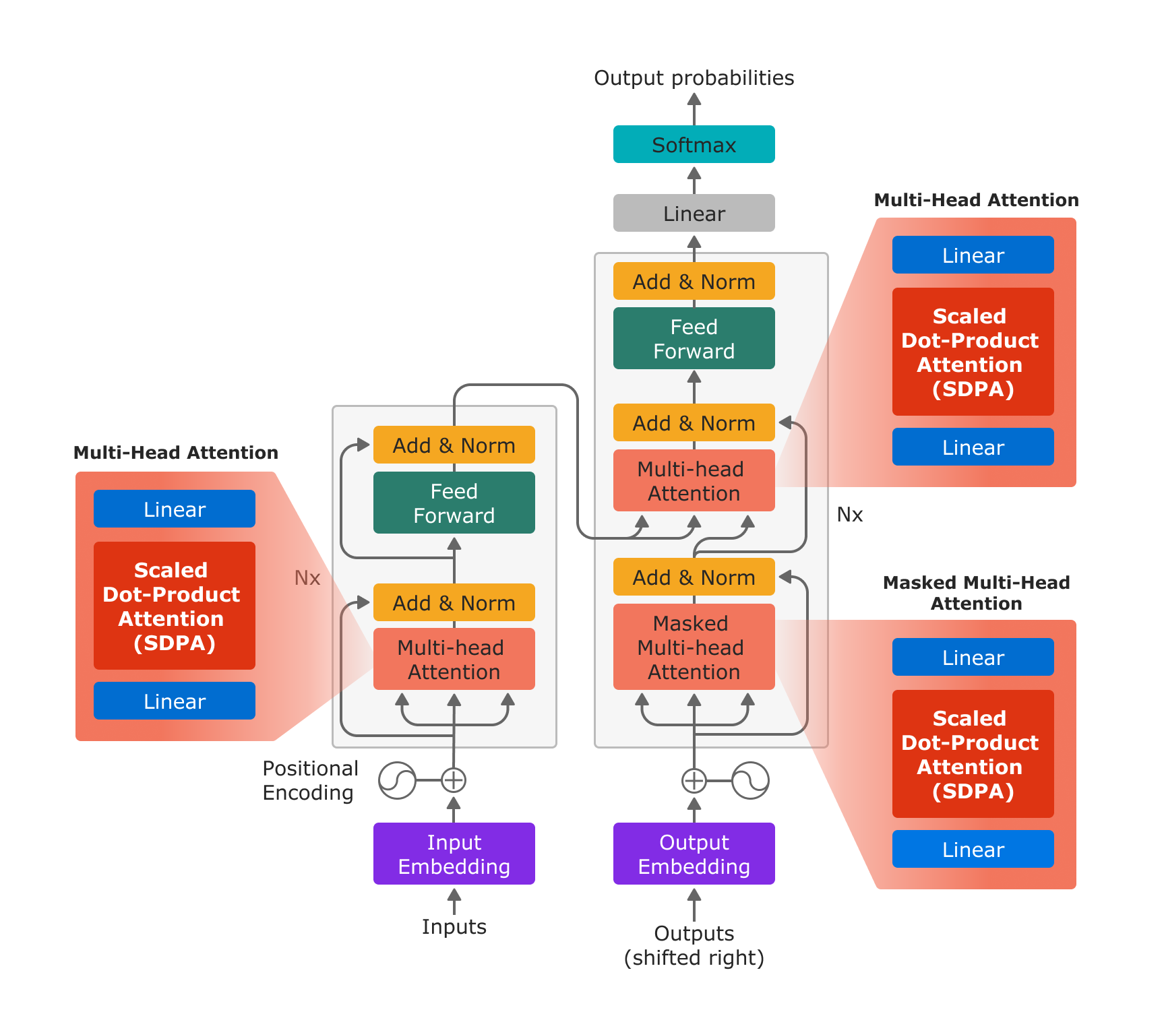
Benefits of Self-Attention in Transformers
Capturing Long-Range Dependencies
Parallelization
Contextual Representations
Scalability
Notes:
https://pytorch.org/blog/accelerating-large-language-models/

Slide 6
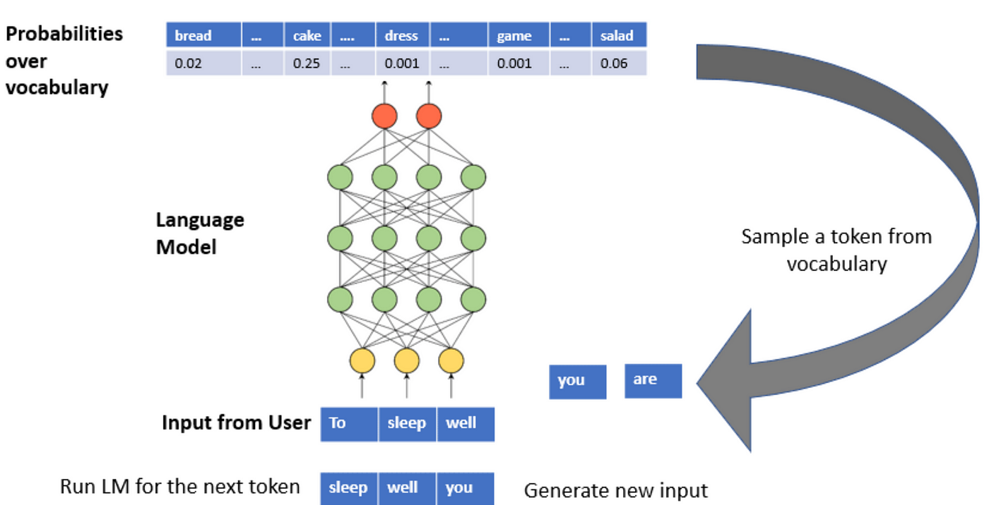

Slide 7
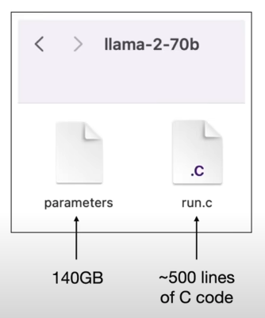
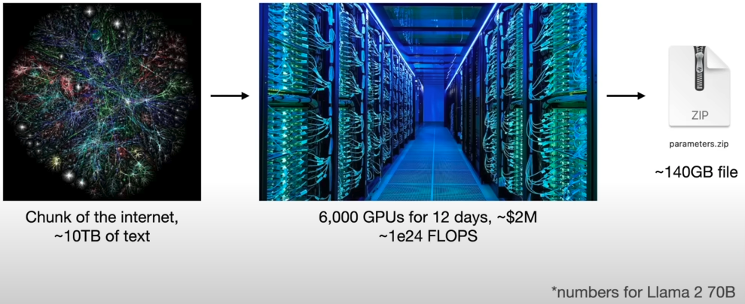
Training Transformer-Based LLM
Notes:
https://www.youtube.com/watch?v=zjkBMFhNj_g

Slide 8
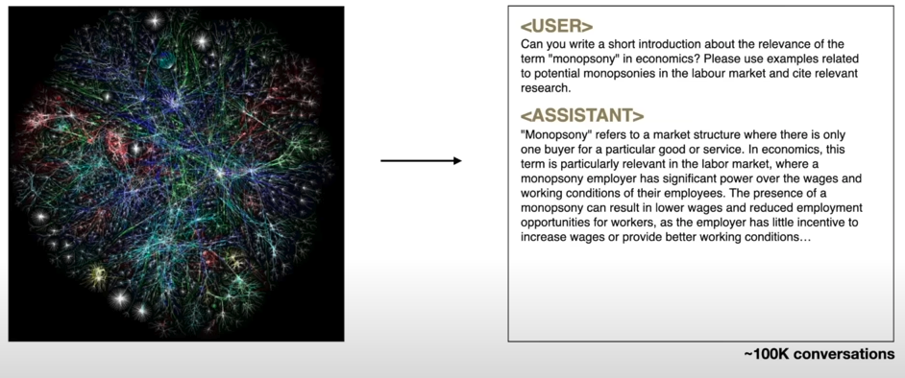
Fine-Tuning

Slide 9
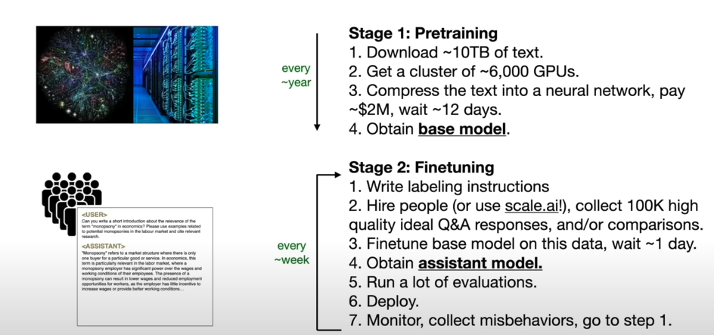
Summary of Training

Slide 10
State-of-the-art Models in Natural Language Processing (NLP)
BERT (Bidirectional Encoder Representations from Transformers)
RoBERTa (Robustly optimized BERT approach)
GPT (Generative Pre-trained Transformer)
T5 (Text-To-Text Transfer Transformer)
BART (Bidirectional and Auto-Regressive Transformers)
ViT (Vision Transformer)(note: computer vision)
LLaMA (Large Language Model Meta AI)

Slide 11
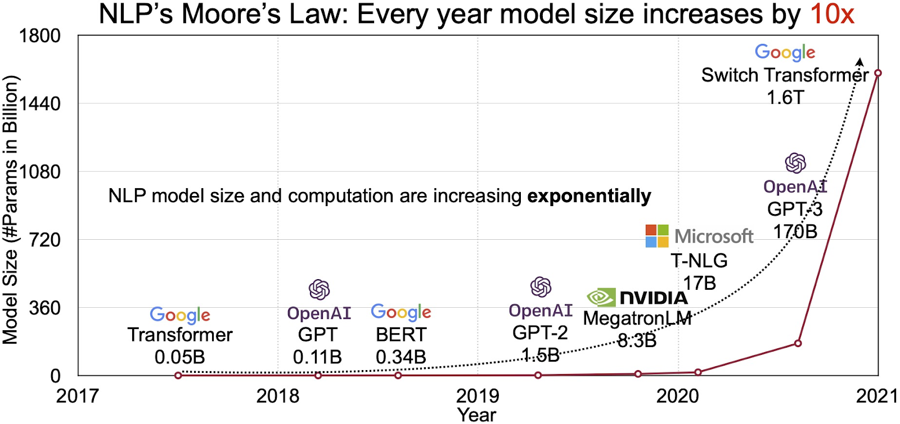
Notes:
https://www.labellerr.com/blog/an-introduction-to-large-language-models-llms/

Slide 12
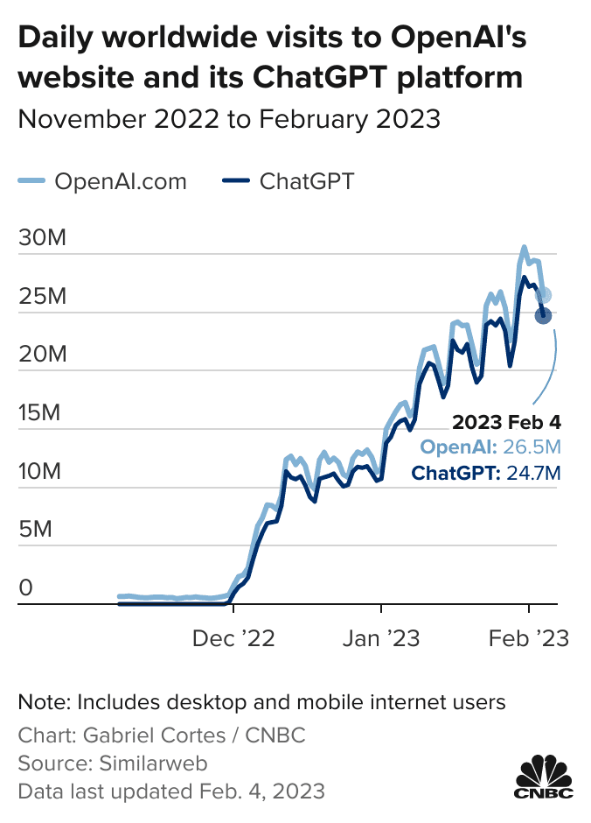
Why Chatgpt Become So Popular?
Quick to Adopt New AI Development
Marketing and Branding: Media attention
Design and Architecture
Bert
Understanding context
masked language model objective
sentiment analysis
question answering
named entity recognition
Chatgpt
generative tasks: unidirectional (autoregressive) approach

Slide 13
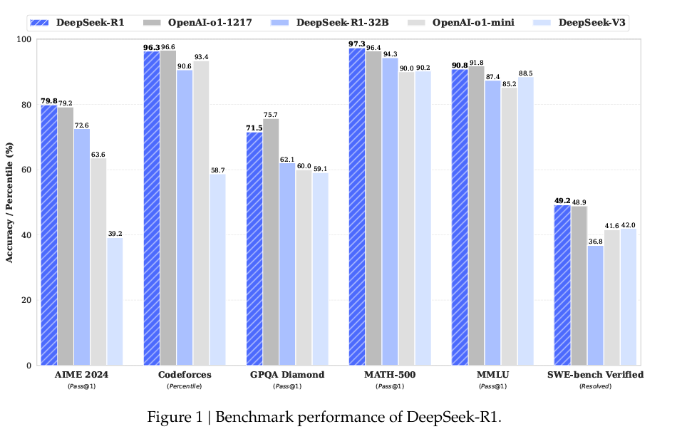

Slide 14
How to Leverage New Developments in AI ?
Develop Your Model from Scratch
A Custom AI Model
API

Slide 15
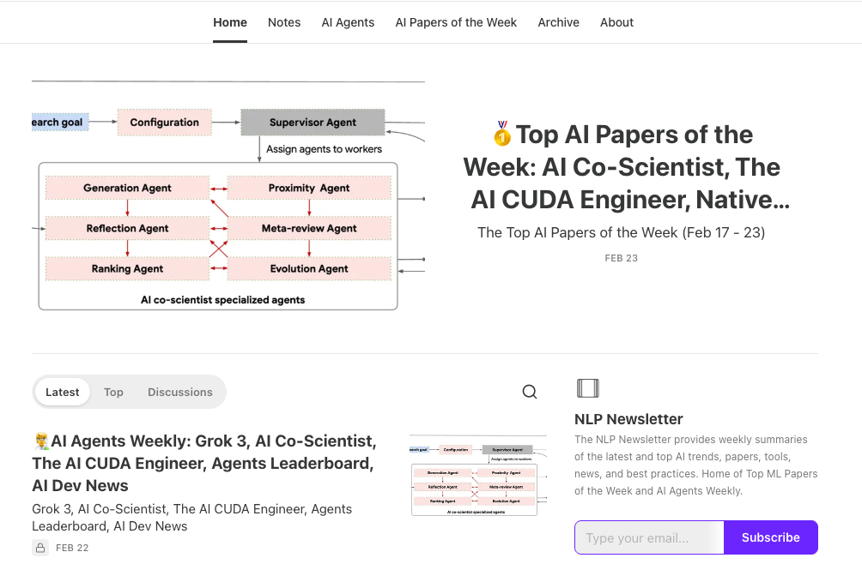
Some Good AI to Follow AI Resources

